Slide 1
EXTERNAL VIVA
IMAGE CAPTIONING: AN ASSISTIVE TECHNOLOGY

Slide 2
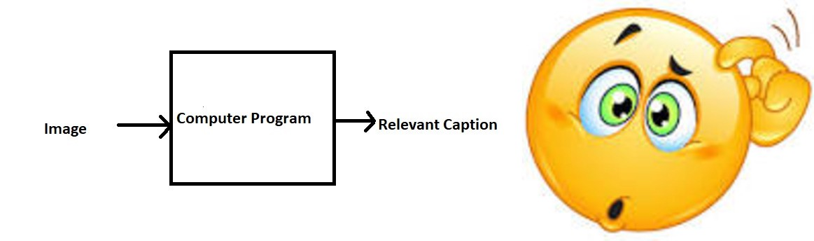
INTRODUCTION
In our project, we do image-to-sentiment generation. The primary purpose of this research is to develop an application capable of classifying images as harmful or sensitive based on the image's content using image captioning. Consider Instagram, for example; there is a sensitive post filter in the app which blurs those images which have something violent or sensitive. To automate this process, we suggest using image captioning and judging the sensitivity of the image based on the sentiment of the caption generated.
Image
Caption
Sentiment
Problem Statement

Slide 3
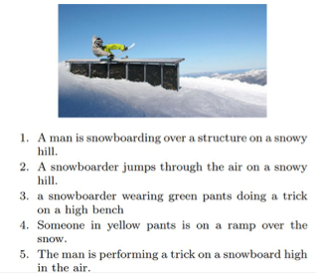
DATASET
The Flickr 8k dataset provided by the University of Illinois at Urbana-Champaign is used as training a model with large number of images would not be feasible on a system which is not a very high-end PC/Laptop. This dataset contains 8000 images each with 5 captions.
Training Set — 6000 images
Dev Set — 1000 images
Test Set — 1000 images

Slide 4
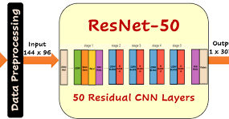
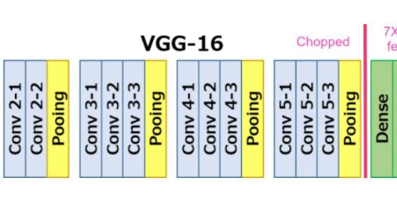
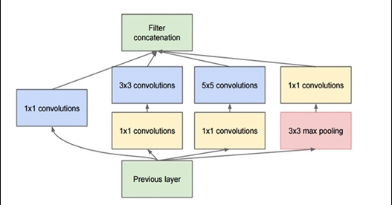
IMAGE FEATURE EXTRACTION
ResNet-50
VGG-16
InceptionV3 & Xception
Shape of image: (1x 2048)
Shape of image: (1x 4096)
Shape of image: (1x 2048)

Slide 5
VGG-16
VGG16 is a convolution neural net architecture which was used to win ILSVR(Imagenet) competition in 2014. It is considered to be one of the excellent vision model architecture till date. Most unique thing about VGG16 is that instead of having a large number of hyper-parameter they focused on having convolution layers of 3x3 filter with a stride 1 and always used same padding and maxpool layer of 2x2 filter of stride 2.
Reference paper:
https://arxiv.org/abs/1409.1556

Slide 6
ResNet-50
ResNet50 is a residual deep learning neural network model with 50 layers. ResNet was the winning model of the ImageNet (ILSVRC) 2015 competition and is a popular model for image classification, it is also often used as a backbone model for object detection in an image.
Reference paper: https://arxiv.org/abs/1512.03385

Slide 7
InceptionV3
With fewer parameters, 42-layer deep learning network, with similar complexity as VGGNet, can be achieved.
AlexNet [2]: 60 million parameters VGGNet [3]: 3× more parameters than AlexNet GoogLeNet / Inception-v1 [4]: 7 million parameters
With 42 layers, lower error rate is obtained and make it become the 1st Runner Up for image classification in ILSVRC (ImageNet Large Scale Visual Recognition Competition) 2015.
Reference paper:
https://arxiv.org/abs/1512.00567

Slide 8
Xception
Xception by Google (2017), stands for Extreme version of Inception, is reviewed. With a modified depthwise separable convolution, it is even better than Inception-v3 (also by Google, 1st Runner Up in ILSVRC 2015) for both ImageNet ILSVRC and JFT datasets.
Reference paper:
https://arxiv.org/abs/1610.02357

Slide 9
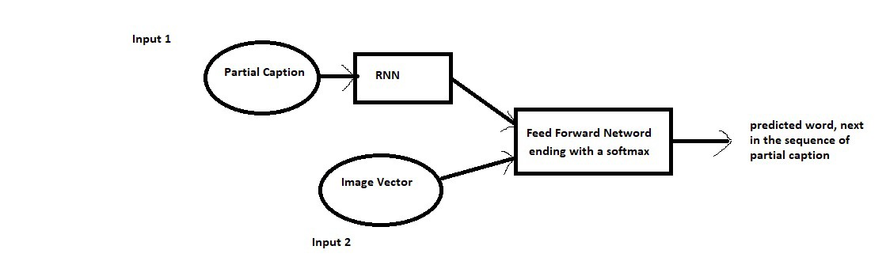
MODEL TRAINING
We try to train all the three image features with a benchmark LSTM model resulting in 4 models:
ResNet50 + LSTM
VGG16 + LSTM
InceptionV3 + LSTM
Xception + LSTM
Model Architecture Reference: https://arxiv.org/pdf/1805.09137.pdf
The results of the comparison of different models can be seen in the next to next slide

Slide 10
MODEL COMPARISON
The maximum length of a caption in the training set comes out to be 34. For training our model, we have used a dropout rate of 0.5 and set the number of epochs as 20.
Attribute | Model 1 | Model 2 | Model 3 | Model 4
Pre-trained model | VGG-16 | ResNet50 | InceptionV3 | Xception
Input shape (Image) | (224,224,3) | (224,224,3) | (299,299,3) | (299,299,3)
Output shape | (1,4096) | (1,2048) | (1,2048) | (1,2048)
Training Parameters | 5,527,963 | 5,003,675 | 5,003,675 | 5,003,675
Training Loss | 3.0928 | 2.8485 | 2.6685 | 2.5990

Slide 11
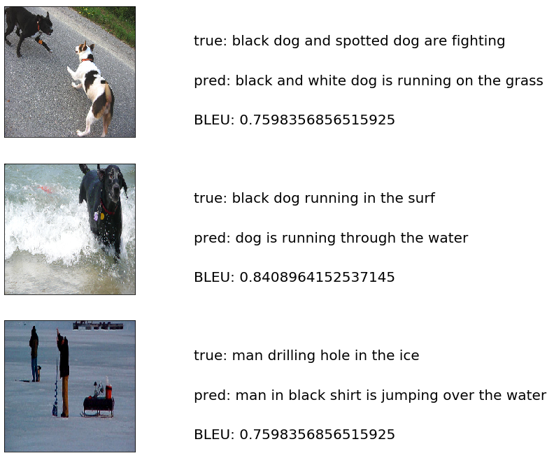
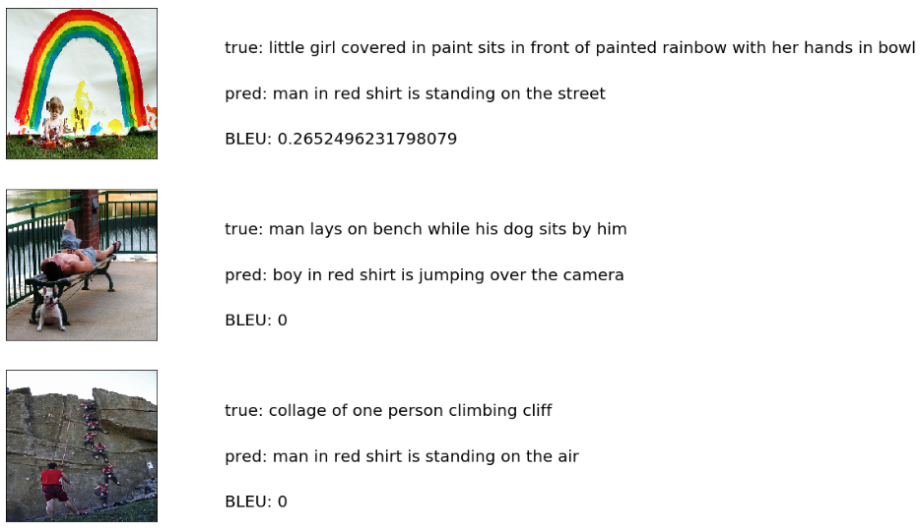
EVALUATION

Slide 12
COMPARISON OF QUALITY OF GENERATED CAPTIONS
BLEU 1 suggests the accuracy up of unigram, BLEU 2 for bigram and so on.
PRE-TRAINED MODEL | BLEU-1 | BLEU-2 | BLEU-3 | BLEU-4
ResNet 50 | 0.519163 | 0.279260 | 0.195061 | 0.093271
VGG-16 | 0.500829 | 0.258246 | 0.175336 | 0.079138
InceptionV3 | 0.519715 | 0.280572 | 0.191283 | 0.089288
Xception | 0.525859 | 0.298624 | 0.212307 | 0.102526

Slide 13
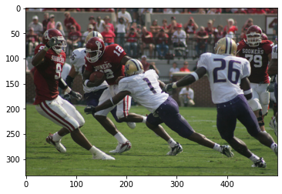
RESULTS
Model | Generated Caption for Fig. 9.
ResNet50 + LSTM | two men attempt to baseball teams are playing soccer on field
VGG16 + LSTM | two men are playing soccer in the field
InceptionV3 + LSTM | baseball player in red and white uniform is running
Xception + LSTM | two men are playing rugby

Slide 14
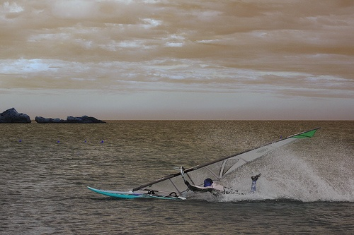
PROPOSED APPLICATION
Caption: A man lose control of his watercraft
Using VADER
Sentiment: {'neg': 0.31, 'neu': 0.69, 'pos': 0.0, 'compound': -0.4019}
sentence was rated as 31.0 % Negative
sentence was rated as 69.0 % Neutral
sentence was rated as 0.0 % Positive
Sentence Overall Rated As Negative

Slide 15
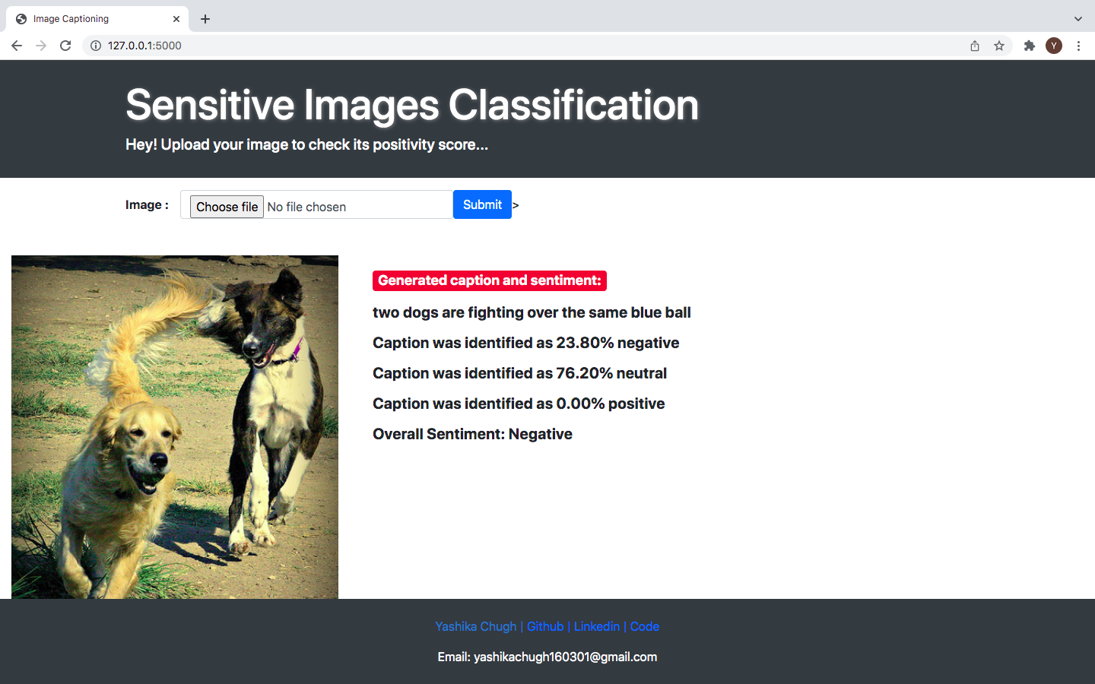
FLASK APPLICATION

Slide 16
THANK YOU
YASHIKA CHUGH
40214803118

